Slide 1

LinkedIn Crawler:
The User Interface
Sprint1
Scrum At Me Bro:
Kevin Seveur
Spencer Bryant
Leah Jean-Francois
Anthony Lieu
Kevin La

Slide 2
The LinkedIn Crawler: Purpose
The LinkedIn Crawler is a collaboration project between three teams
The goal is to create a web based application that GSU students can use to locate current and former GSU students using select search criteria
LinkedIn.com will be the repository where we will query all of our searches from
We will create a desktop application utilizing JavaFX for the view component. The resulting JavaFX code is in an FXML format.

Slide 3
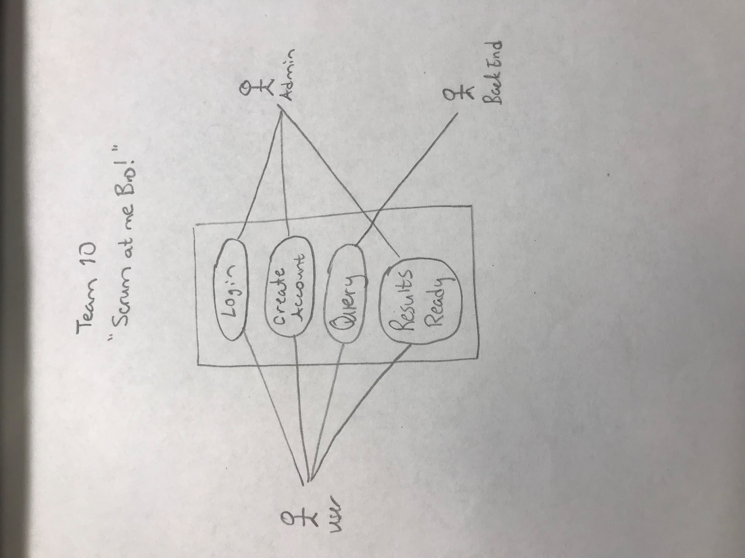
Use Case 1
The user will be asked to Login or Create Account
The user will also be allowed to put in a search query
Once the results are ready they will be notified

Slide 4
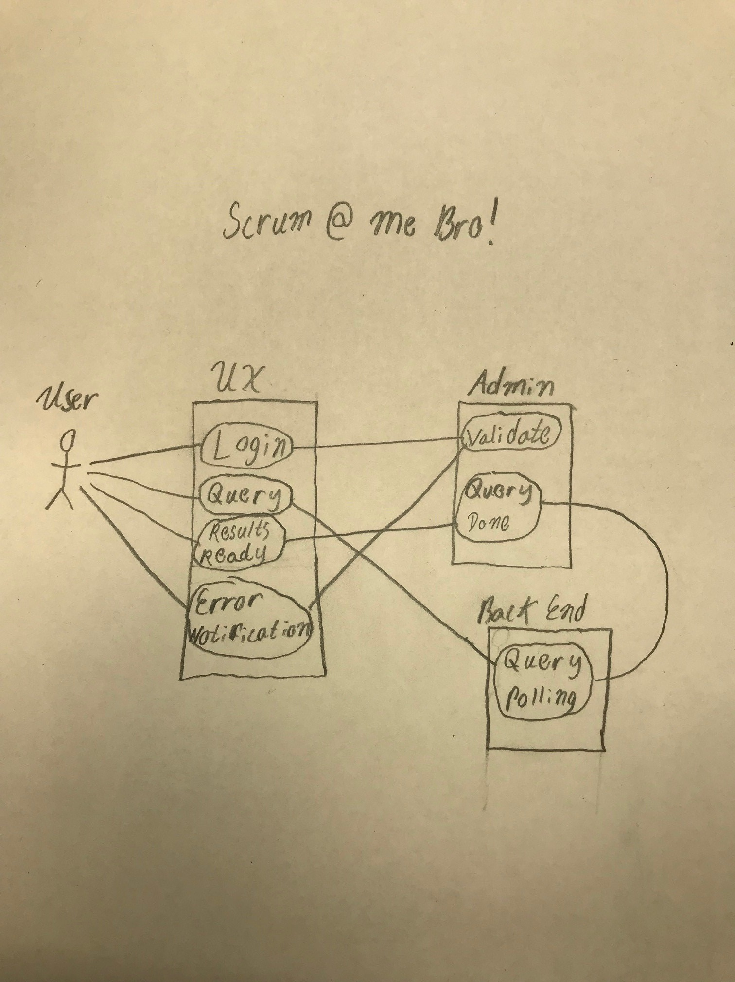
Use Case 2
This User has an account and will login directly to have their credentials validated by the admin team
If validation is good they will be allowed to start searching but if not they will be asked to login again.
Once the user is validated they will be able to move forward to search and receive their results

Slide 5
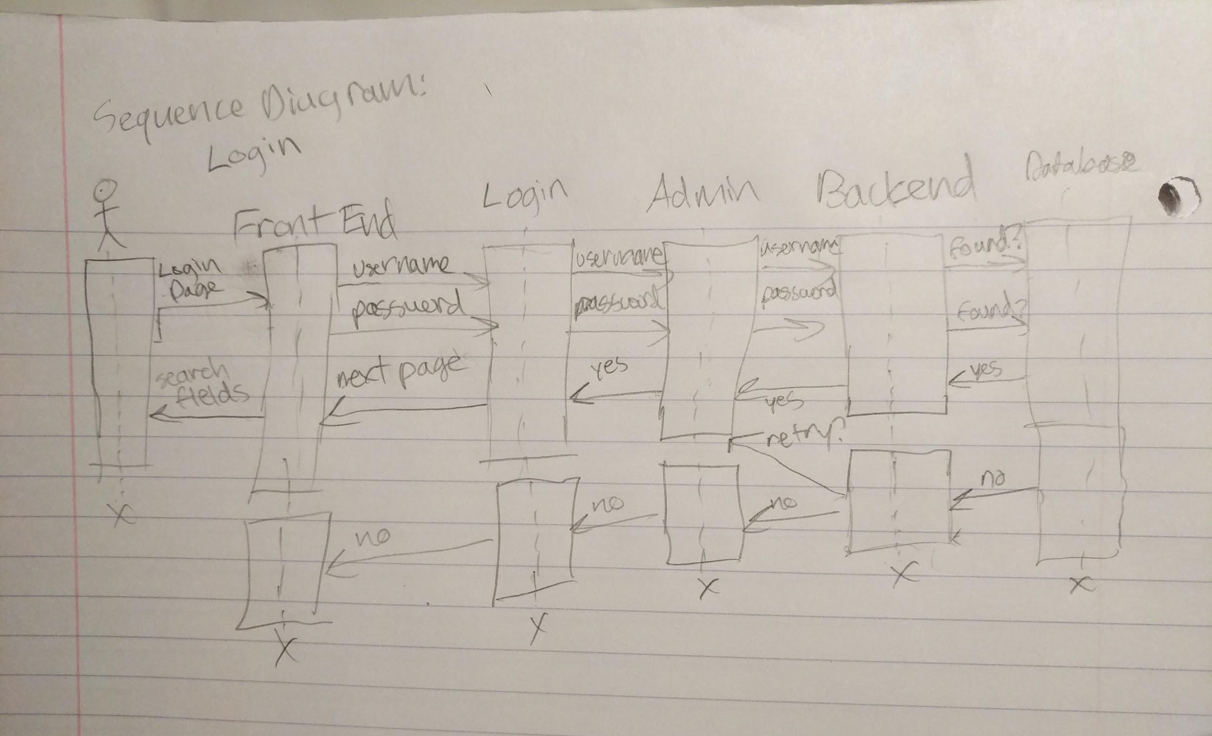
Login Sequence Diagram

Slide 6
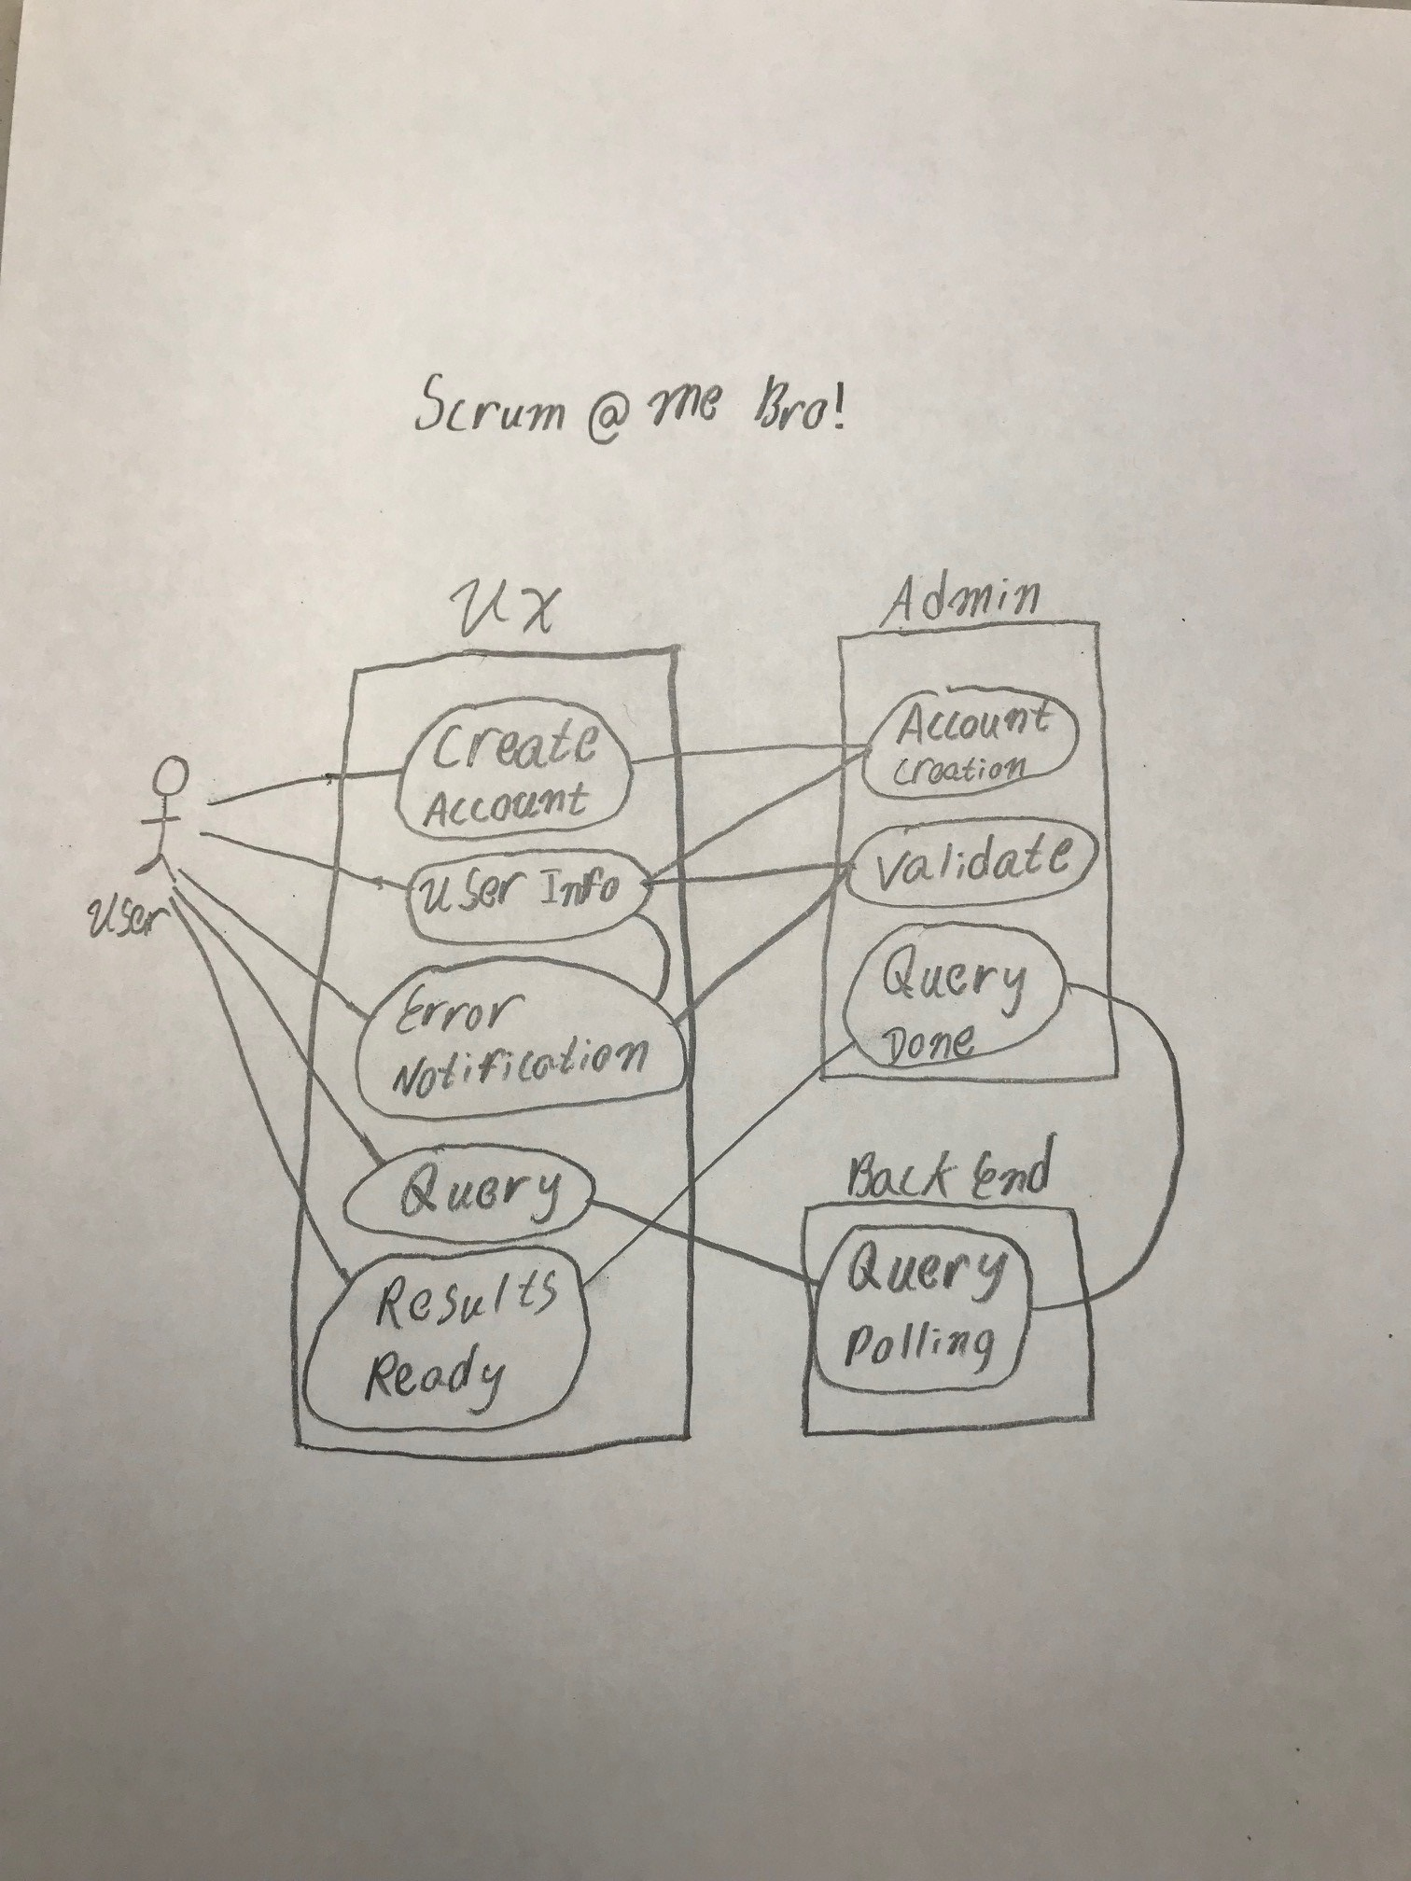
Use Case 3
This User needs to create an account
If validation is good they will be allowed to start searching but if not they will be asked to login again.
Once the user is validated they will be able to move forward to search and receive their results

Slide 7
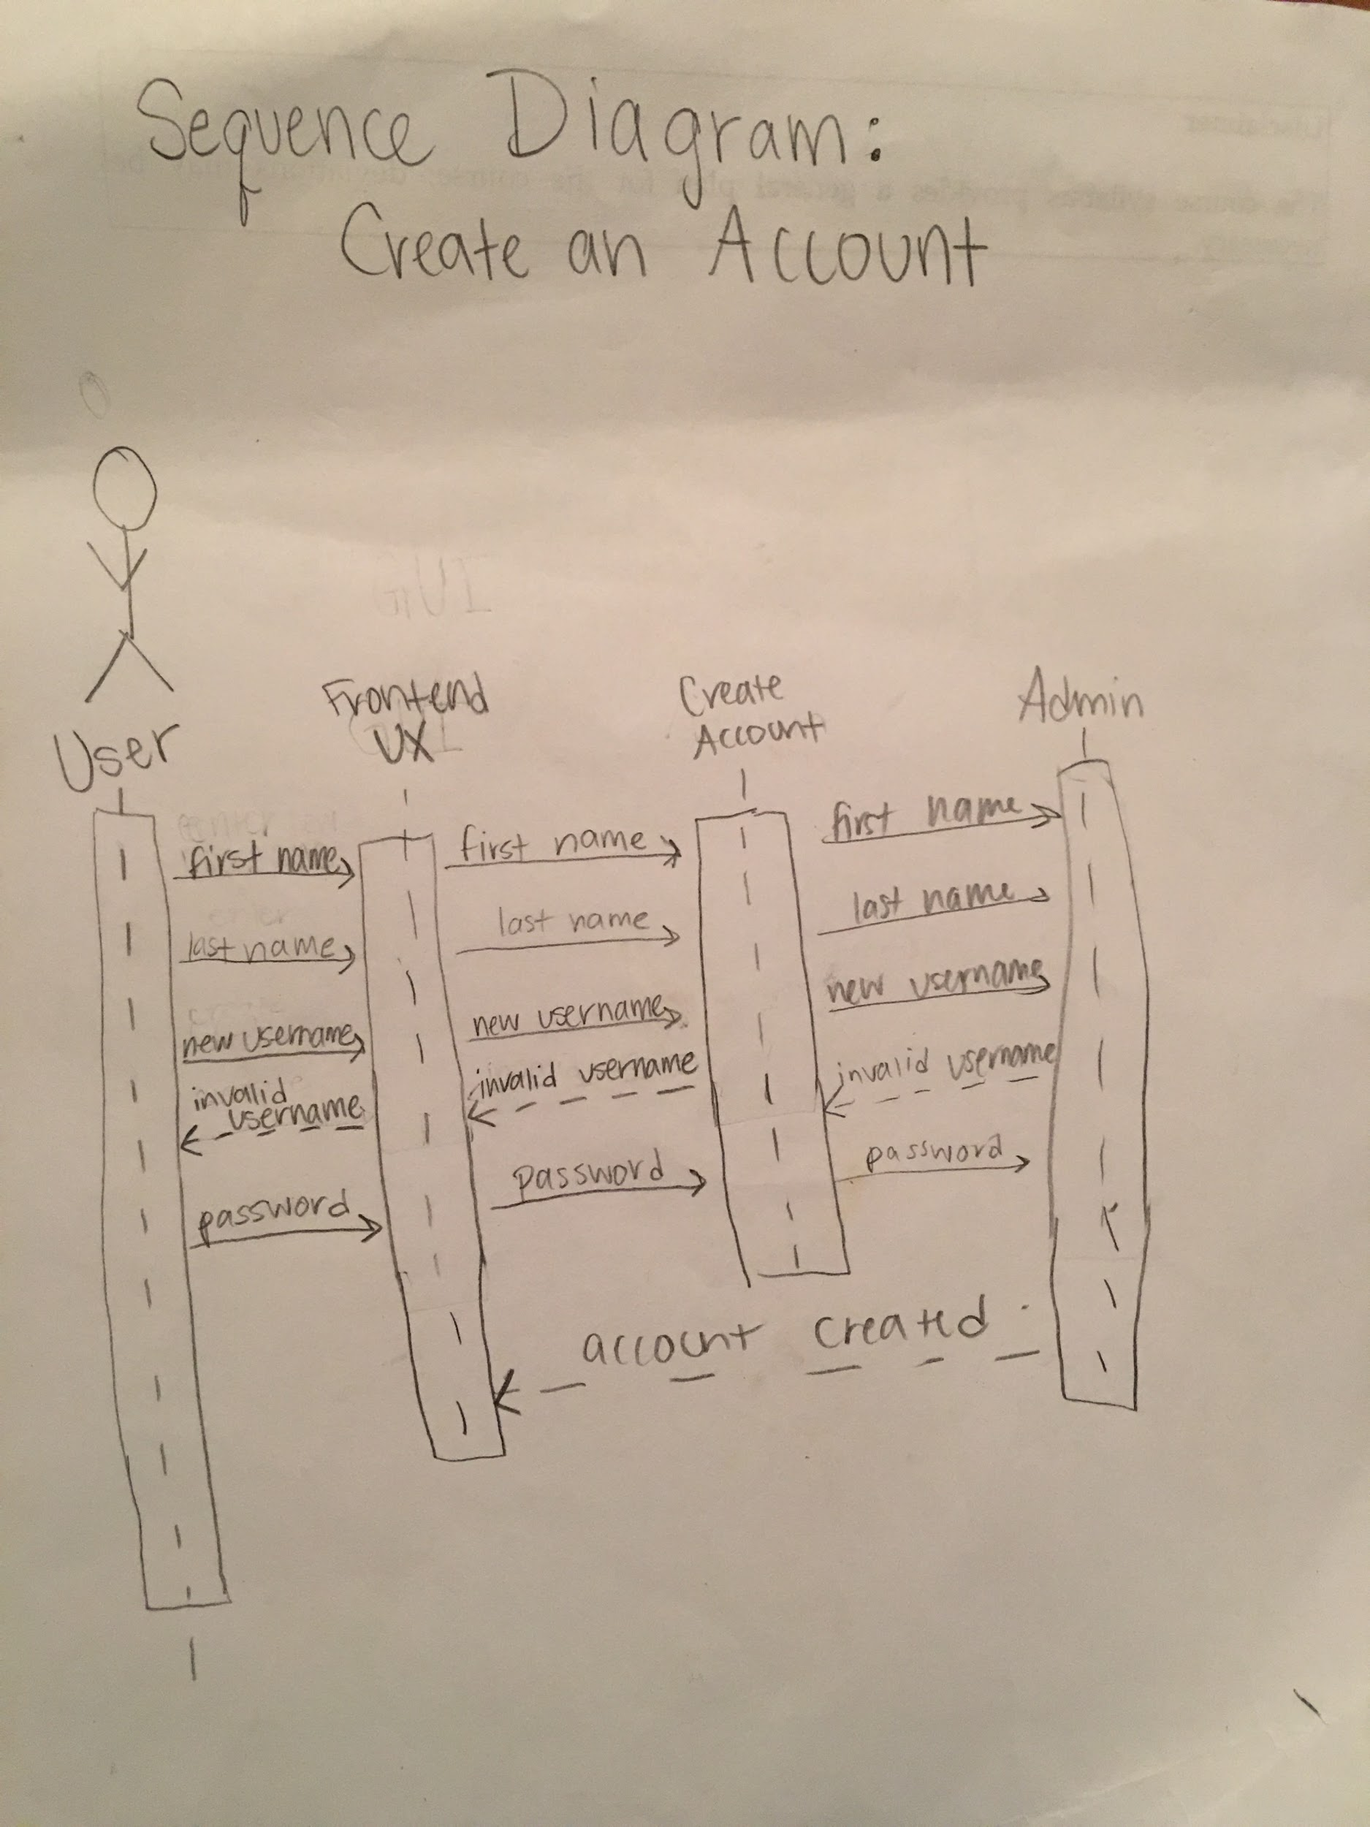
Create Account Sequence Diagram

Slide 8
Projected Risks
Linkedin Api: We discussed with the other groups and found that we needed to submit a request to Linkedin to have access to certain information.
Receiving csv files: Once the user has submitted the search query, we need still need a way to figure out how the user will receive the results and how the user can access it.

Slide 9
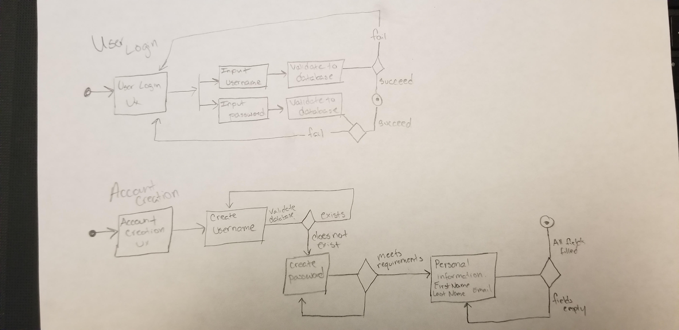
Login and Create Account State Diagram

Slide 10
Completed Story Cards
User Interface Research
User/Navigation flow
Research JavaFx
Good for local based site, lose benefits on web based applications
GUI Look and Feel
Use GSU colors

Slide 11
Backlog
Research LinkedIn
Group discussion
Research Backend Communication
How we will send the query for our search

Slide 12
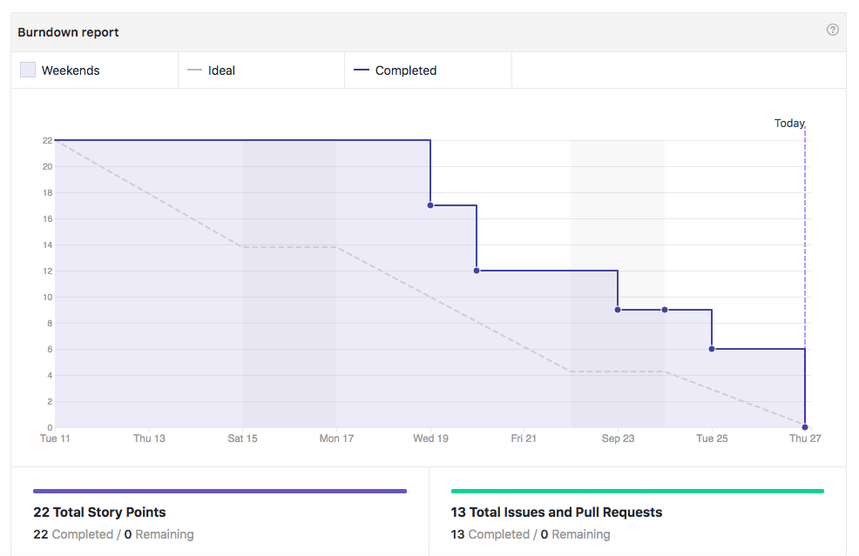
Burndown Chart

